Slide 1
Connecting to the ME GTOR Storage Space

Slide 2
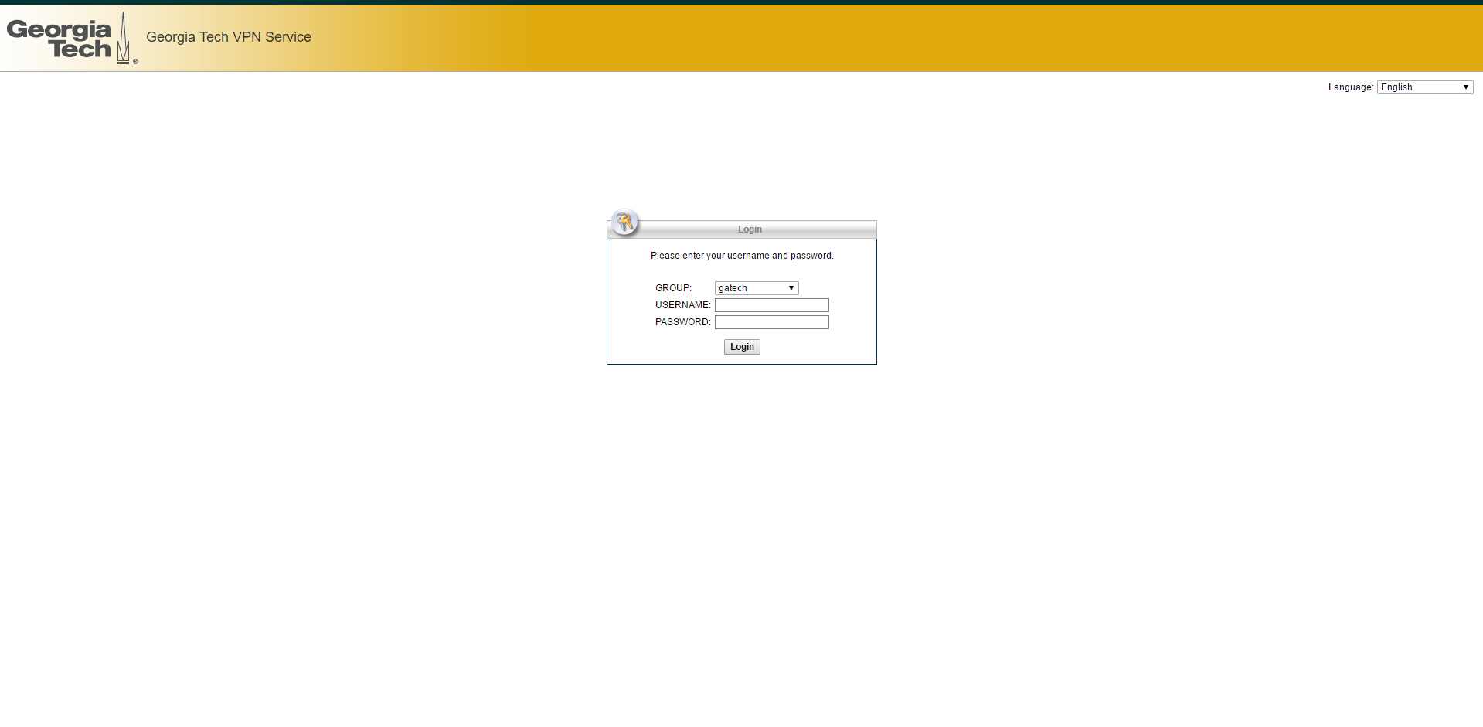
First: Make sure you have been granted access to the storage space. Ask the team lead or IT lead to request access for you. Go to the following address and log in: https://ipsec6.vpn.gatech.edu/+CSCOE+/logon.html#form_title_text

Slide 3
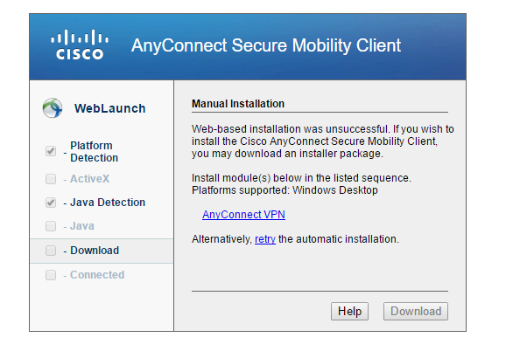
- You will reach this page. If web-based instllation was unsuccessful, click on Anyconnect VPN - This will download an anyconnect exe file - Execute the file and install the Anyconnect Client

Slide 4
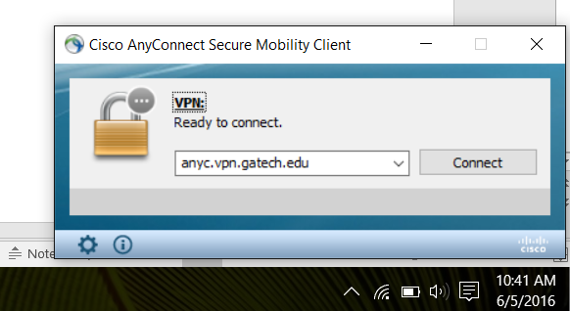
- After installing the client, go ahead and open it - The window below should open - Type in the address as shown and hit connect

Slide 5
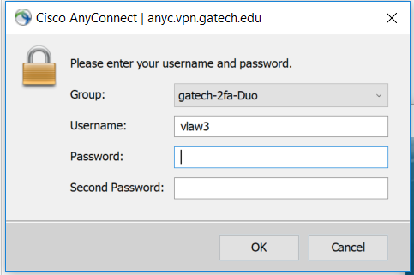
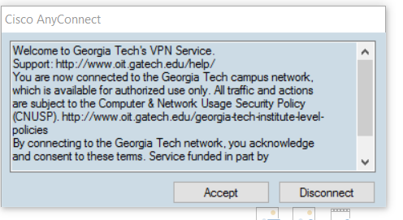
Enter login credentials and then hit accept
Your GT PW
Go to your Duo Mobile App to get key

Slide 6
- You are now connected to the Georgia tech network

Slide 7
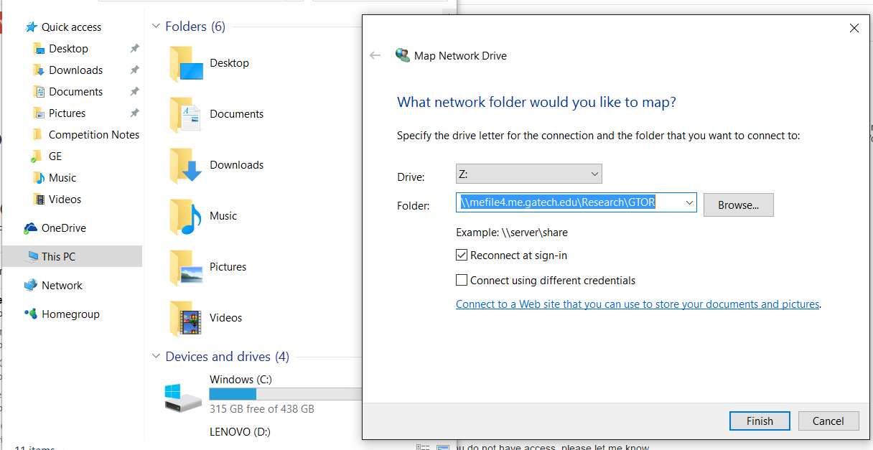
-Windows Users: Once you are connected to the GT Network via Anyconnect, right click “This Pc” and click on map network properties - Pick any drive letter not in use and enter address: \\ad.gatech\mefs$ -Mac Users:
\\ad.gatech\mefs$

Slide 8
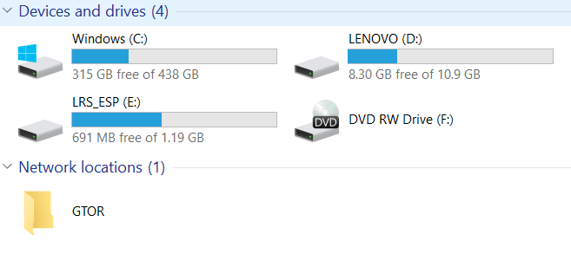
There should now be a GTOR folder in your network locations

Slide 9
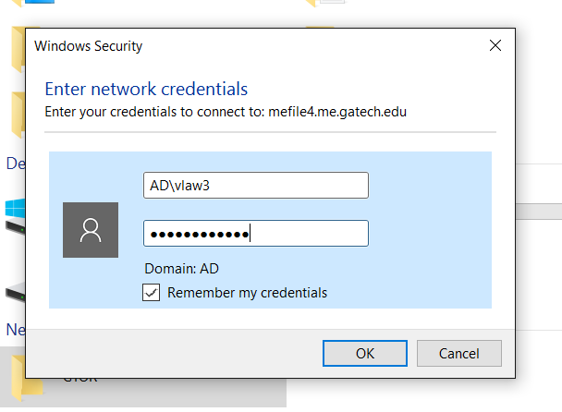
- For first time access, there will be a window that pops up prompting you to enter login credentials - Enter your GT login info as shown below - Don’t forget to put AD\ in front of your username

Slide 10
You are now connected to the GTOR Server Files

